Slide 1
Operating Systems and File Management

Slide 2
Chapter Contents
Chapter 4: Operating Systems and File Management
2
Section A: Operating System Basics
Section B: Today’s Operating Systems
Section C: File Basics
Section D: File Management
Section E: Backup Security

Slide 3
Operating System Basics
Chapter 4: Operating Systems and File Management
3
Operating System Activities
User Interfaces
The Boot Process

Slide 4
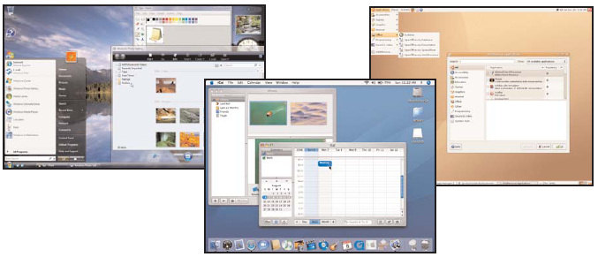
Operating System Activities
Chapter 4: Operating Systems and File Management
4
An operating system is a type of system software that acts as the master controller for all activities that take place within a computer system
Notes:
4

Slide 5
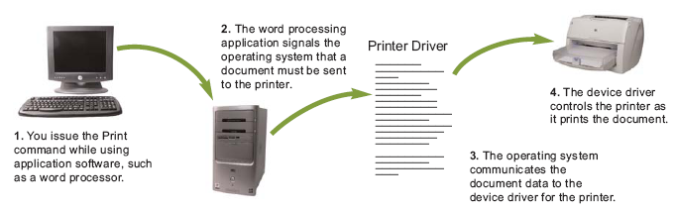
Operating System Activities
Chapter 4: Operating Systems and File Management
5
Notes:
5

Slide 6
Operating System Activities
Chapter 4: Operating Systems and File Management
6
Multitasking provides process and memory management services that allow two or more tasks, jobs, or programs to run simultaneously
Within a single program, multithreading allows multiple parts, or threads, to run simultaneously
An operating system’s multiprocessing capability supports a division of labor among all the processing units

Slide 7
Operating System Activities
Chapter 4: Operating Systems and File Management
7
Operating System Categories
Single-user operating system
Multiuser operating system
Server operating system
Desktop operating system

Slide 8
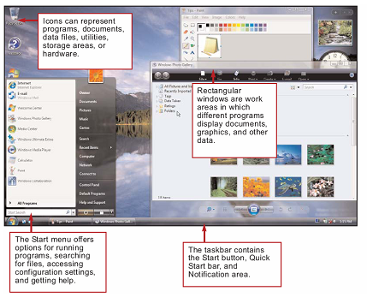
User Interfaces
Chapter 4: Operating Systems and File Management
8
The combination of hardware and software that helps people and computers communicate with each other
Notes:
8
Figures 4-7 and 4-8

Slide 9
User Interfaces
Chapter 4: Operating Systems and File Management
9
Menus, submenus, and dialog boxes
Notes:
9
Figures 4-10 and 4-11

Slide 10
The Boot Process
Chapter 4: Operating Systems and File Management
10
During the boot process, the operating system kernel is loaded into RAM
The kernel provides essential operating system services
Your computer’s small bootstrap program is built into special ROM circuitry housed in the computer’s system unit

Slide 11
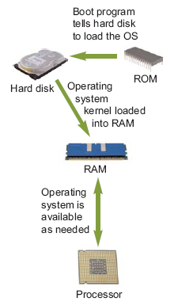
The Boot Process
Chapter 4: Operating Systems and File Management
11
Notes:
11
Figure 4-13

Slide 12
Today’s Operating Systems
Chapter 4: Operating Systems and File Management
12
Microsoft Windows
Mac OS
UNIX and Linux
DOS
Handheld Operating Systems

Slide 13
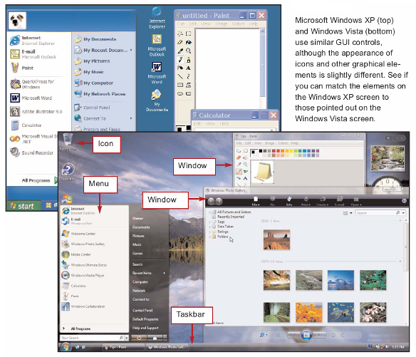
Microsoft Windows
Chapter 4: Operating Systems and File Management
13
Notes:
13
Figure 4-14

Slide 14
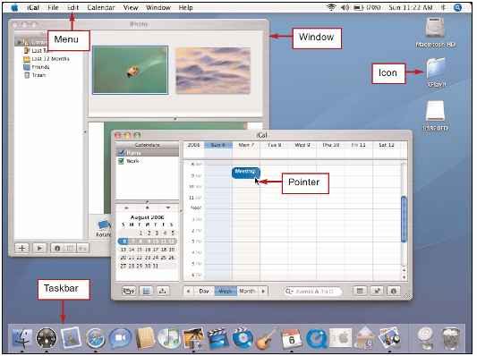
Mac OS
You can tell when you’re using
Mac OS by the Apple logo that
appears on the menu bar. The
Mac OS X interface includes all
the standard elements of a GUI,
including icons, menus,
windows, and taskbars.
Chapter 4: Operating Systems and File Management
14
Notes:
14
Figures 4-17

Slide 15
Mac OS
On a Macintosh computer with Boot Camp, you can boot
into Mac OS X or
into Windows.
Chapter 4: Operating Systems and File Management
15
Notes:
15
Figure 4-19

Slide 16
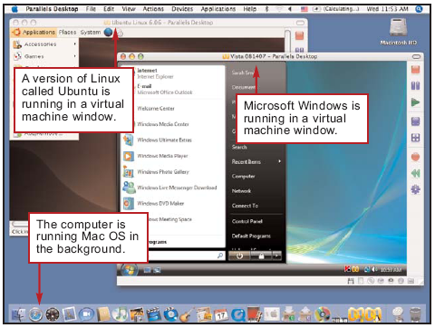
Mac OS
Chapter 4: Operating Systems and File Management
16
Mac OS X on an Intel Mac offers the ability to run Windows and Windows application software in addition to software designed for the Macintosh
Dual boot
Notes:
16
Figure 4-20

Slide 17
UNIX and Linux
Chapter 4: Operating Systems and File Management
17
Several Web sites offer a Linux distribution, which is a package that contains the Linux kernel, system utilities, applications, and an installation routine

Slide 18
UNIX and Linux
Linux users can choose from
several graphical interfaces.
Pictured here is the popular
KDE graphical desktop.
Chapter 4: Operating Systems and File Management
18
Notes:
18
Figure 4-21

Slide 19
DOS
Chapter 4: Operating Systems and File Management
19
Disk Operating System
First operating system that many used
Notes:
19
Figure 4-22

Slide 20
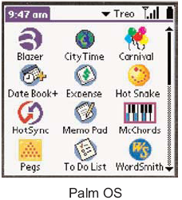
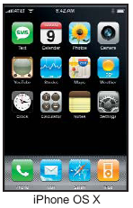
Handheld Operating Systems
Chapter 4: Operating Systems and File Management
20
Notes:
20
Figure 4-23

Slide 21
File Basics
Chapter 4: Operating Systems and File Management
21
File Names and Extensions
File Directories and Folders
File Formats

Slide 22
File Names and Extensions
Chapter 4: Operating Systems and File Management
22
You must adhere to file-naming conventions when saving files
Maximum length
Prohibited characters
No reserved words
Case sensitivity
File extensions are usually related to the file format
Native file format
Notes:
22
Figure 4-24

Slide 23
File Directories and Folders
C:\Music\Reggae\Marley One Love.mp3
Chapter 4: Operating Systems and File Management
23
An operating system maintains a directory for each disk, tape, CD, DVD, or USB flash drive
Root directory
Subdirectory
Depicted as folders
A computer’s file location is defined by a file specification, or path

Slide 24
File Formats
Chapter 4: Operating Systems and File Management
24
Windows uses a file association list to link a file extension to its corresponding application software
Although a file extension is a good indicator of a file’s format, it does not really define the format
A file header is a section of data at the beginning of a file that contains information about a file

Slide 25
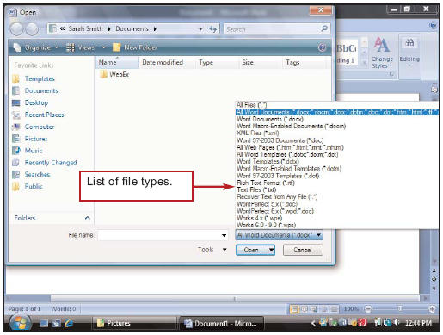
File Formats
Chapter 4: Operating Systems and File Management
25
A software application can open files that exist in its native file format, plus several additional file formats

Slide 26
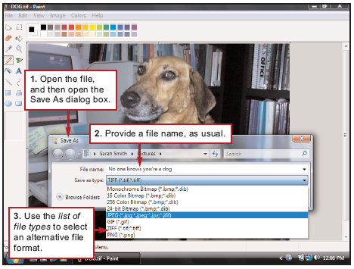
File Formats
An easy way to convert a file
from one format to another is
to open it with an application
that supports both file formats,
and then use the Save As dialog
box to select an alternative
file format.
Chapter 4: Operating Systems and File Management
26
Notes:
26
Figure 4-32 (movie)

Slide 27
File Management
Chapter 4: Operating Systems and File Management
27
Application-based File Management
File Management Utilities
File Management Metaphors
Windows Explorer
File Management Tips
Physical File Storage

Slide 28
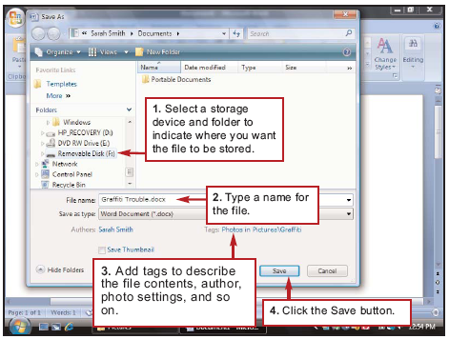
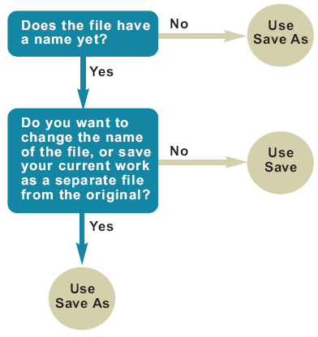
Application-based File Management
Chapter 4: Operating Systems and File Management
28
Applications typically provide a way to open files and save them in a specific folder on a storage device
Notes:
28
Figures 4-33 and 4-34

Slide 29
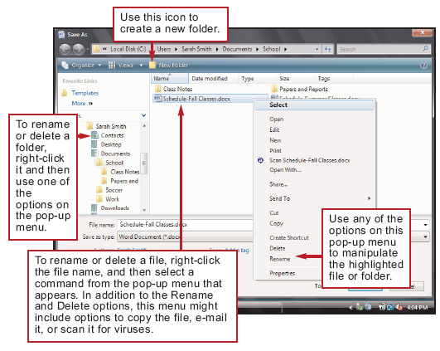
Application-based File Management
The Save As dialog box
of most Windows applications uses the
operating system’s file
management utility, so
you can carry out a wide
variety of file and folder
tasks such as creating,
renaming, and deleting
files.
Chapter 4: Operating Systems and File Management
29
Notes:
29
Figure 4-35

Slide 30
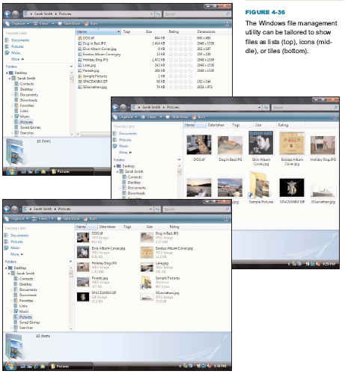
File Management Utilities
File management utilities show you the files stored on your disks and help you work with them
Chapter 4: Operating Systems and File Management
30
Notes:
30
Figure 4-36

Slide 31
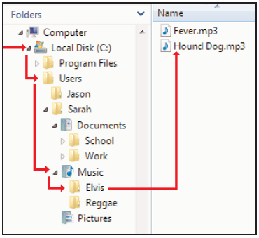

File Management Metaphors
Chapter 4: Operating Systems and File Management
31
Storage metaphors help you visualize and mentally organize the files on your disks
Logical storage models
Notes:
31
Figures 4-37 and 4-38

Slide 32
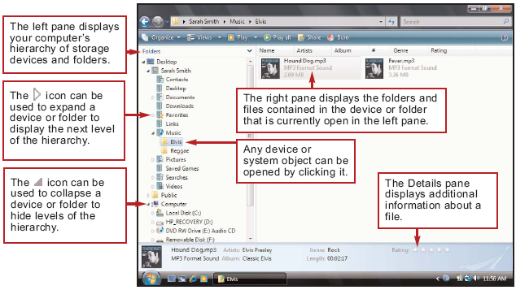
Windows Explorer
Windows Explorer makes it easy to drill down through the levels of the directory hierarchy to locate a folder or file.
Chapter 4: Operating Systems and File Management
32
Notes:
32
Figure 4-39

Slide 33
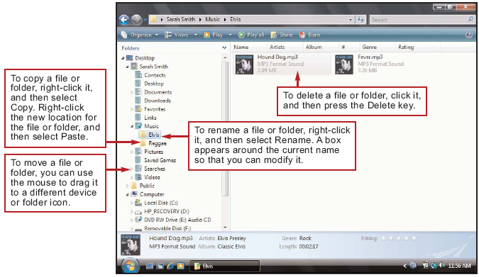
Windows Explorer
Chapter 4: Operating Systems and File Management
33
Windows Explorer allows you to manipulate files and folders in the following ways:
Rename
Copy
Move
Delete
Notes:
33
Figure 4-40

Slide 34
File Management Tips
Chapter 4: Operating Systems and File Management
34
Use descriptive names
Maintain file extensions
Group similar files
Organize your folders from the top down
Consider using the default folders
Do not mix data files and program files

Slide 35
File Management Tips
Chapter 4: Operating Systems and File Management
35
Don’t store files in the root directory
Access files from the hard disk
Follow copyright rules
Delete or archive files you no longer need
Be aware of storage locations
Back up

Slide 36
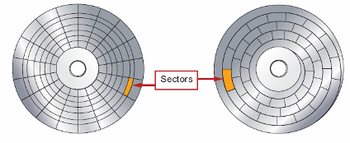
Physical File Storage
Chapter 4: Operating Systems and File Management
36
The physical storage model describes what happens on the disks and in the circuits when files are stored
Storage media must be formatted before it can store files
Formatting utilities divide the disk into tracks and sectors
Notes:
36
Figure 4-42

Slide 37
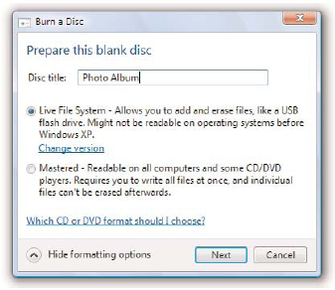
Physical File Storage
CDs and DVDs can be created using mastering or packet-writing techniques. Mastering creates disks that can be used more reliably on a wide variety
of computers and standalone players. Packet writing is more flexible for disks that you plan to
use only on your own computer.
Chapter 4: Operating Systems and File Management
37
Notes:
37
Figure 4-43

Slide 38
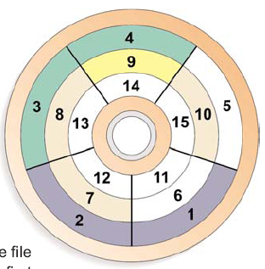
Physical File Storage
The file system keeps track of the names and locations of files
NTFS
Master File Table (MFT)
FAT32
File Allocation Table (FAT)
Chapter 4: Operating Systems and File Management
38
Notes:
38
Figure 4-44

Slide 39
Physical File Storage
Chapter 4: Operating Systems and File Management
39
Deleting a file changes the status of that file’s clusters to empty and removes the file name from the index file
The file’s data is still there
File shredder software overwrites “empty” sectors with random 1s and 0s
Files in the Windows Recycle Bin and similar utilities can be undeleted

Slide 40
Physical File Storage
Chapter 4: Operating Systems and File Management
40
Fragmented files are stored in noncontiguous clusters and decrease performance
Defragmentation utilities rearrange files so that they are stored in contiguous clusters
Notes:
40
Figure 4-45

Slide 41
Backup Security
Chapter 4: Operating Systems and File Management
41
Backup Basics
Data File Backup
System Backup
Boot and Recovery Disks

Slide 42
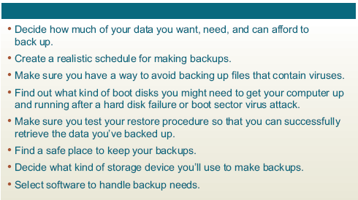
Backup Basics
Chapter 4: Operating Systems and File Management
42
A backup stores the files needed to recover data that’s been wiped out by operator error, viruses, or hardware failures
Notes:
42
Figure 4-46

Slide 43
Backup Basics
Chapter 4: Operating Systems and File Management
43
Your backup schedule depends on how much data you can afford to lose
You should run an up-to-date virus check as the first step in your backup routine
The backup device you select depends on the value of your data, your current equipment, and your budget

Slide 44
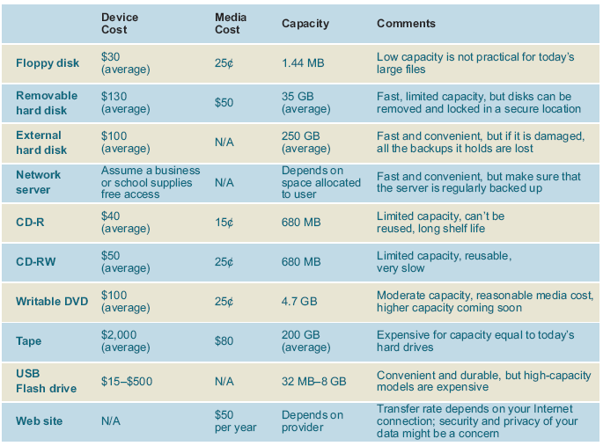
Backup Basics
Chapter 4: Operating Systems and File Management
44
Notes:
44
Figure 4-48

Slide 45
Data File Backup
Chapter 4: Operating Systems and File Management
45
Most computers are equipped with a writable CD or DVD drive with adequate storage capacity for a typical computer owner’s data files
Store all files to be backed up in the same location
Back up Internet connection information, e-mail folders, e-mail address book, favorite URLs, downloads and validation codes, and other configuration information

Slide 46
Data File Backup
Chapter 4: Operating Systems and File Management
46
To restore from a data file backup, you simply copy files from your backup to your hard disk

Slide 47
System Backup
Chapter 4: Operating Systems and File Management
47
To make a backup, you can use backup software
Backup software is supplied with most tape drives and other backup devices

Slide 48
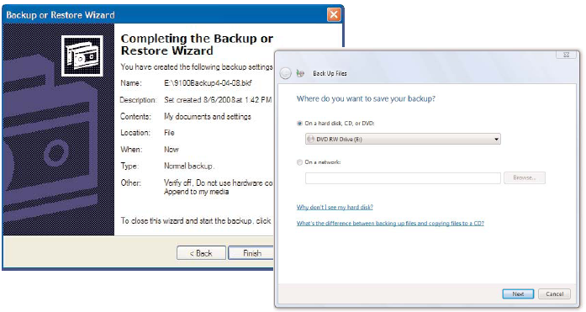
System Backup
Chapter 4: Operating Systems and File Management
48
Notes:
48
Figure 4-51

Slide 49
System Backup
Chapter 4: Operating Systems and File Management
49
A full backup makes a fresh copy of every file in the folders you’ve specified for the backup
A differential backup makes a backup of only those files that were added or changed since your last full backup session
An incremental backup makes a backup of the files that were added or changed since the last backup—not necessarily the files that changed from the last full backup
Most experts recommend that you keep more than one set of backups

Slide 50
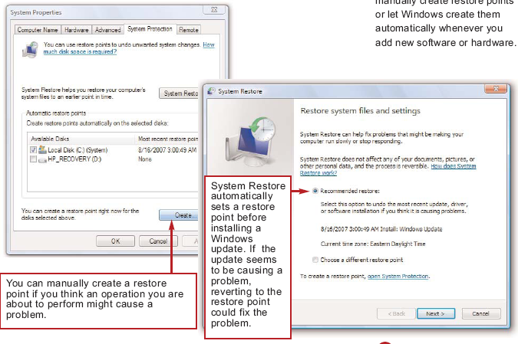
System Backup
Restore points back up personal
preferences and configuration settings stored in the Windows Registry. You can manually create restore points or let Windows create them automatically whenever you
add new software or hardware.
Chapter 4: Operating Systems and File Management
50
Notes:
50
Figure 4-52

Slide 51
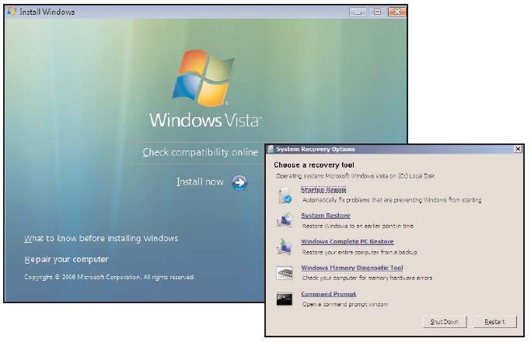
Boot and Recovery Disks
Chapter 4: Operating Systems and File Management
51
A boot disk is a removable storage medium containing the operating system files needed to boot your computer without accessing the hard disk
Windows Installation CD
Notes:
51
Figure 4-53

Slide 52
Boot and Recovery Disks
A recovery disk loads hardware drivers and user settings as well as the operating system
Sometimes included with new computer systems
Available on the Web
Recovery partition
Chapter 4: Operating Systems and File Management
52
Notes:
52
Figure 4-55

Slide 53
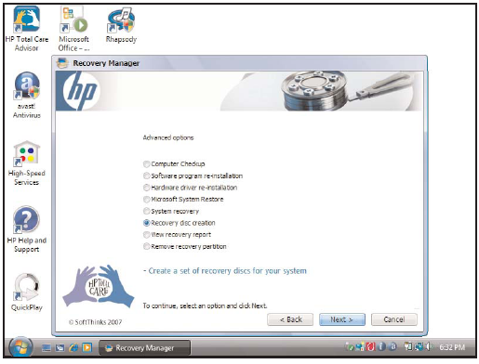
Boot and Recovery Disks
Chapter 4: Operating Systems and File Management
53

Slide 54
Boot and Recovery Disks
Chapter 4: Operating Systems and File Management
54
You can create a custom recovery CD that contains your computer’s current settings and device drivers
Norton Ghost is a product of Symantec, which also provides a more specialized recovery disk called the Symantec Recovery Disk
Certain PC manufacturers have pre-installed Norton Ghost and the recovery environment on some of their computers

